Slide 1
Pump it Up
MMAI 869 – Team Adelaide

Slide 2
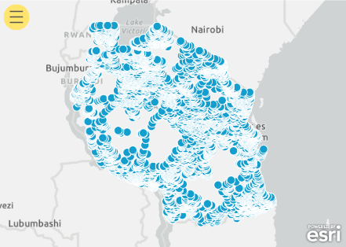
Business Context
25 million people in Tanzania (43% of the country's population) do not have access to clean, portable water.
Problem statement:
How can we optimize resources to provide clean, portable water to all communities?
Solution:
Classify water pumps as:
Functional
Non-functional
Functional but needs repair
This would help the government allocate resources effectively.
Non-Functional Waterpoints in Tanzania

Slide 3


Water pumps in Tanzania Profile
Multi-class problem
Data Sets
instances for training, with inconsistent format in some features
3
59,400
statuses: Functional, Function Needs Repair (FNR), Non-Functional
Missing Values
Features
features consisting of geographical, date/time, other attributes about each water pump
10
features contain missing values
39

Slide 4
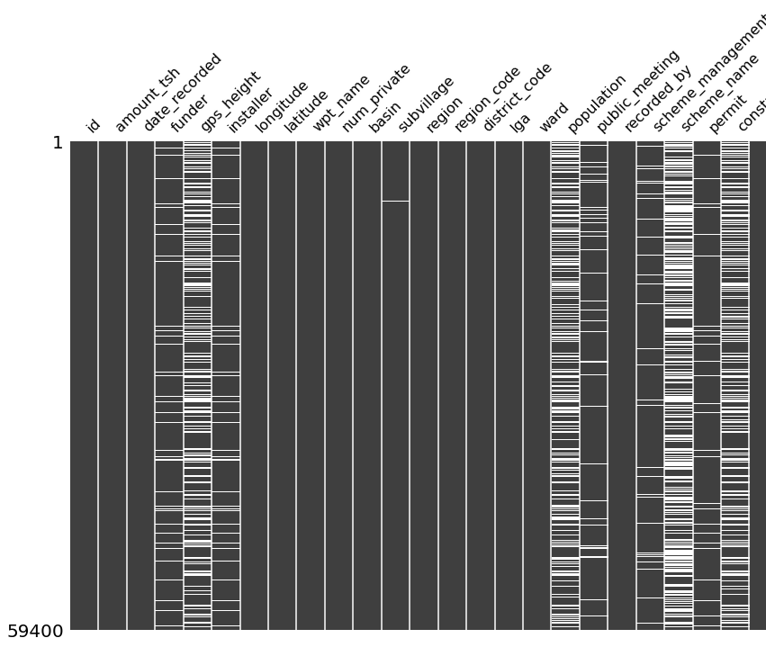
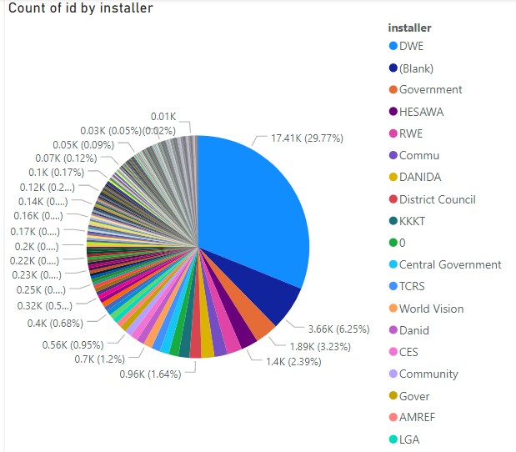
Key Observation
01
02
Missing Values
Lots of Categories

Slide 5
Pre-processing & Feature Engineering

Slide 6
01
02
03
Noise/Outliers
Missing Values
New Features
Outliers Removal
Missing Value Imputation
Date / Geographic features
04
05
Other Transformations
06
Rare Category
One-Hot
Rare Category encoding / Coalescing
Handle Categorical features
Log Transformation, Lower case, etc
Notes:
Class-based outliers are outliers that would not be considered outlying if the class label was ignored. As a result, adding class labels to the mix complicates things, mostly in the way that it brings subjective understanding of what is considered to be an outlier

Slide 7
Key Steps
Class-based outliers
What we learned…
01
You won't be able to tell who's outliers until you include the class labels

Slide 8
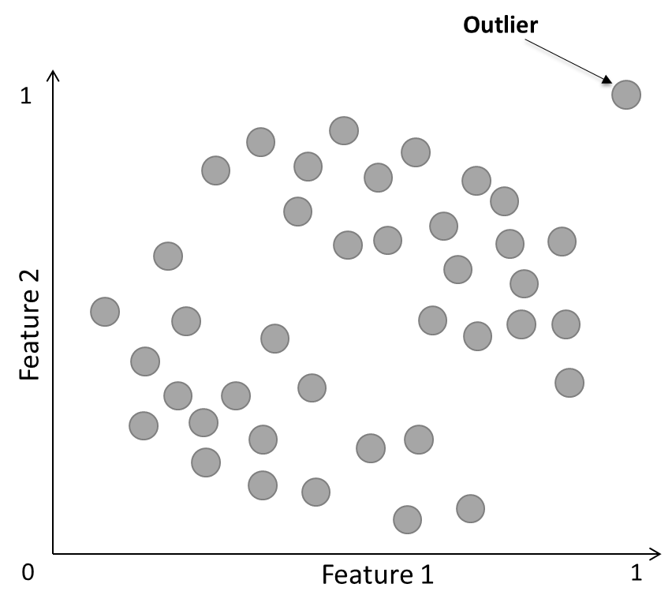
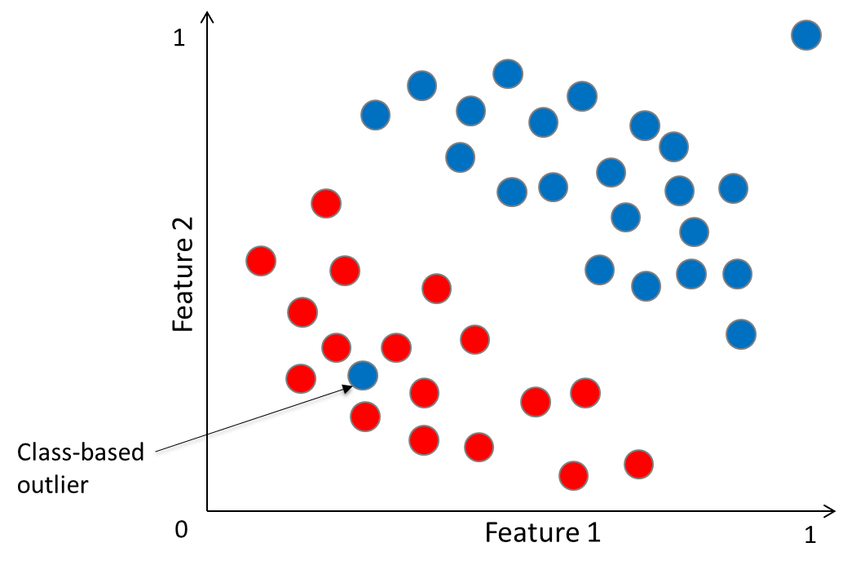
Reducing Outliers…
After
Before
Boosting algorithms are robust to general outliers. However, class-based outliers can cause them to overfit.
Class | Count of Class Outliers | % of Class Outliers
Functional | 250 | 0.77%
Functional Needs Repair | 443 | 10.26%
Non-Functional | 1021 | 4.47%
TOTAL | 1714 | 2.88%
Accuracy
Before: 80.02
After: 81.33

Slide 9
Key Steps
Class-based outliers
What we learned…
01
You won't be able to tell who's outliers until you include the class labels
Geocoding to fill missing values
02
Reversed geocoder library will take you longitude and latitude data and return the nearest town/city/sub-village

Slide 10
Cleaning Missing Values…
Before
After
Longitude | Latitude | Sub-village
-11.36 | 35.44 | NaN
-10.34 | -34.02 | NaN
83.04 | -79.11 | NaN
24.78 | 40.22 | NaN
Longitude | Latitude | Sub-village
-11.36 | 35.44 | Subvillage1
-10.34 | -34.02 | Subvillage4
83.04 | -79.11 | Subvillage2
24.78 | 40.22 | Subvillage3

Slide 11
Key Steps
Class-based outliers
What we learned…
01
You won't be able to tell who's outliers until you include the class labels
Geocoding to fill missing values
02
Reversed geocoder library will take you longitude and latitude data and return the nearest town/city/sub-village
Time and Date feature
03
We created new features like Age / date recorded month from construction to recorded

Slide 12
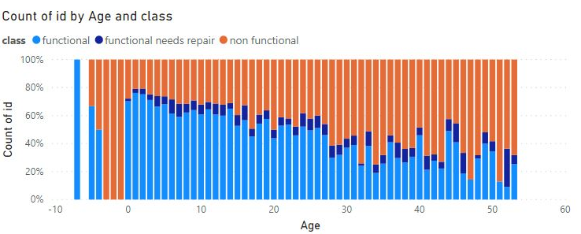
Feature Creation…
Before
After
Date_recorded | Construction_year
2013-12-01 | 1990
2002-08-08 | 1992
2001-01-08 | 1998
1999-05-04 | 1986
2012-11-05 | 2001
Age = date_recorded – construction_year
23
10
3
13
11
Notes:
More examples in table

Slide 13
Modeling

Slide 14
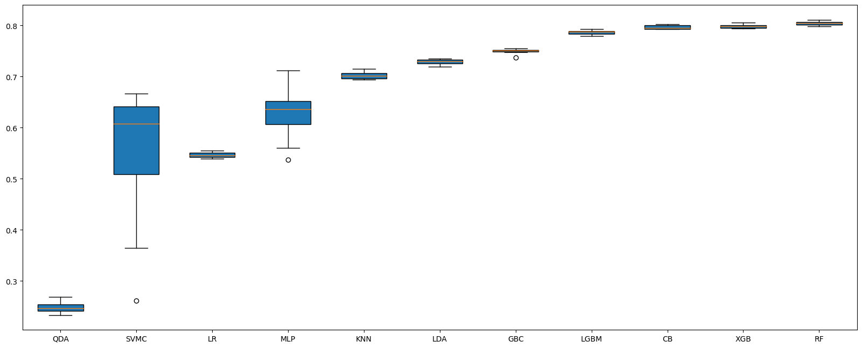
Algorithm Comparison
*RBF Support Vector Classification: Best Cross-validation score = 0.6193

Slide 15

Hyperparameter Tuning
Initially we tried to start with Grid Search
Took too much time & processing power
RandomizedSearchCV
GridSearchCV
Manual Tuning
Used random search to get a "better-than-default" set of hyperparameters
Used grid search and added +/- bounds to the hyperparameters found in random search
Varied one hyperparameter at a time and compare cross validation score
Accuracy
0.7865
0.8022
0.8093

Slide 16
Ensemble
To improve results, we applied StackingClassifier
Proof of Concept:
RandomForest
CatBoost
LightGBM*
Models Stacked | Results
Random forest + Gradient boost | 0.7075
RF + GB + LightGBM | 0.7125
Level-0 models
Observations:
Additional models can increase accuracy
Takes very long with diminishing returns
Construct stacked model using top performing models for accuracy gains
Meta-learner
LogisticRegression*
DrivenData Results... 0.8191

Slide 17
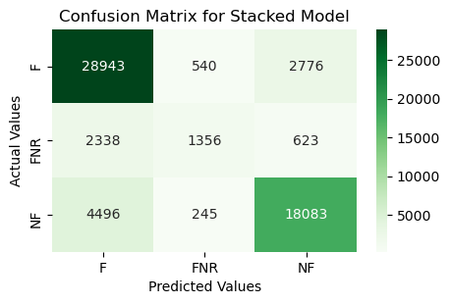
Confusion Matrix & Metrics
precision recall f1-score support
functional 0.81 0.90 0.85 32259
funct. needs repair 0.63 0.31 0.42 4317
non functional 0.84 0.79 0.82 22824
accuracy 0.81 59400
macro avg 0.76 0.67 0.70 59400
weighted avg 0.81 0.81 0.81 59400
Notes:
High Precision: less false positives
High Recall: less false negatives
Model is biased towards the F/NF classes

Slide 18
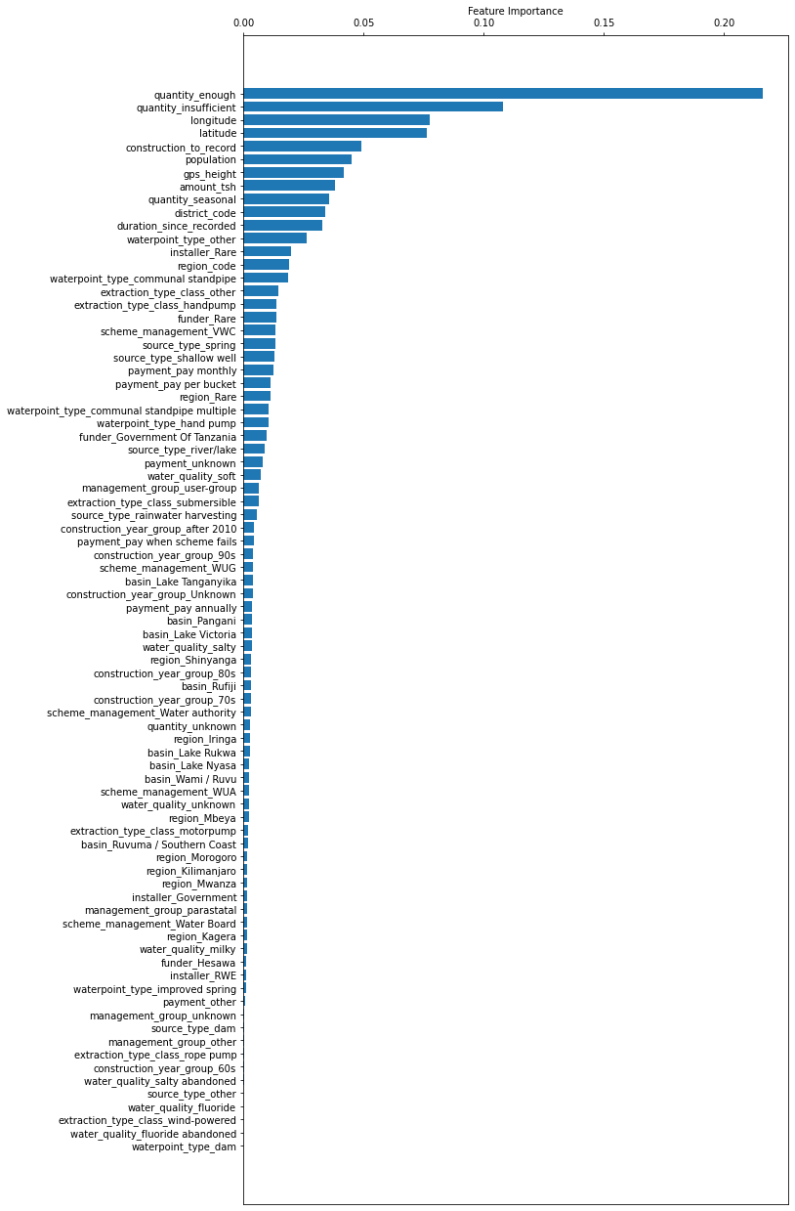
Feature Importance
Water Level
Geo coordinate
Age of water pump

Slide 19
Application

Slide 20
Model Use
Functional
Improve access of clean water to communities
OBJECTIVE
Model Prediction
More people with access to clean water (>>43%)​
​
More functional waterpoints​
​
Lower labor cost​
Functional Needs Repair
Plan Maintenance and Reduce labor cost
Non-Functional
Repair or remove waterpoint,
Reallocate Resources

Slide 21
Financial Impact
Current Scenario
Random Action
Our Model
Cost Matrix (USD cost)
Predicted
F
FNR
NF
Labor Cost = 200 USD / wp
0 | 200 | 200
6200 | 200 | 0
6200 | 0 | 200
Actual
Cost
FNR
Predicted
NF
F
FNR
NF
Govt Healthcare cost = 6200 USD / wp
210 mil
78 mil
58 mil
Cost Matrix (Lives lost)
Predicted
F
FNR
NF
Current scenario
Costs USD $210 million
Costs 23,900 lives of infants
Random action
Save USD $132 million
Save 15,994 lives
Our model
Saves USD $152 million
Saves 17,929 lives
F
0 | 0 | 0
0.7 | 0 | 0
0.7 | 0 | 0
Actual
Avg Infant deaths per NF wp = 0.7
FNR
NF

Slide 22

Lessons Learned & Next Steps
Lessons Learned
Next Steps
Pre-processing
Seasonality, math transformations
Over-sampling by SMOTE
Cleaning of categorical features
Class distributions for better coalescing
Supervised techniques for missing value imputation
Feature Selection using Recursive Feature Elimination
Modeling
Explore models in the H2O package
Use packages such as Optuna for tuning
Experiment with a 2-Class model
Code Refactoring
Create functions for all steps to help sharing and reusing of code among team members
Approach
- How to effectively code as a group: balance between many approaches vs splitting sections - Prioritize objectives in big projects
ML Knowledge
- Significance of Feature Engineering over other techniques
- Effectiveness of Boosting models

Slide 23
Questions?

Slide 24
Appendix

Slide 25
01
02
03
04
Noise/Outliers
Missing values
Normalization
New features
Outliers Removal
Missing Value Imputation
Not Required
Date / geographic features
Such as:
IQR capping
Outliers removal
Z-score
All models are tree-based
Also:
KMeans clustering to classified data based on longitude and latitude data
Calculate haversine distance
Also:
Categorical: mode/mean/median
Numeric: mean/median
05
06
Other Transformation
07
Rare category
One-hot
Handle categorical features with so many unique values
Increase dimensionality for good
Log Transformation , Lower case ,etc
Funder
installer
Region
Sub-village
Payment
Funder
Installer
Logarithm (population + 1)
Notes:
Class-based outliers are outliers that would not be considered outlying if the class label was ignored. As a result, adding class labels to the mix complicates things, mostly in the way that it brings subjective understanding of what is considered to be an outlier

Slide 26
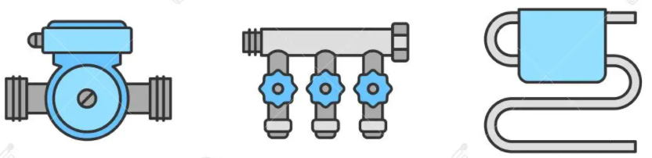
Missing Values & Data Cleaning
The installer feature - spelling mistakes, wrong abbreviations and inconsistent capitalization
Converted data to lowercase. Reduced number of mistakes and applied grouping through simple rules
Many outlier values of latitude and longitude
Replaced with the median values of the corresponding region_code
Data contains features with very similar categories
Delete scheme_management, quantity_group, water_quality, payment_type, extraction_type, waterpoint_type_group, region_code
Missing values in public_meeting and permit
Replaced with median values. Adopted similar technique for subvillage and scheme_name
The features date_recorded and recorded_by were deleted because their values were meaningless.

Slide 27
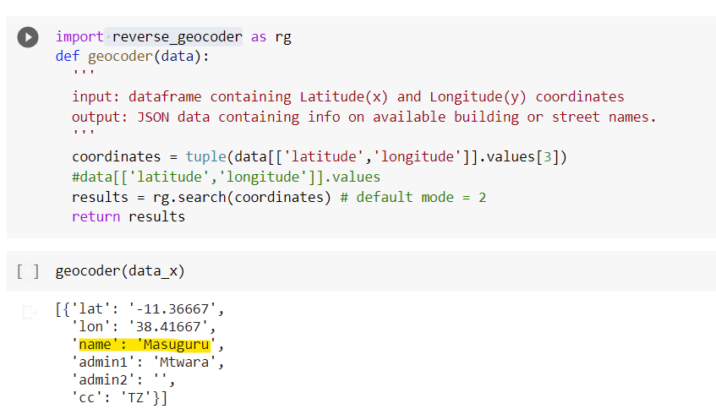
Reverse Geocoding

Slide 28
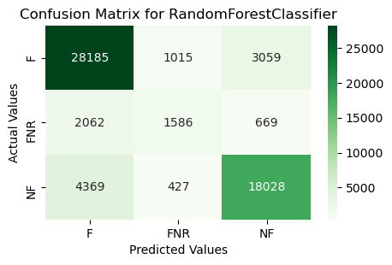


Confusion Matrices (cross-val-predict)

Slide 29
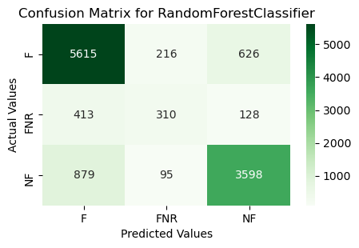
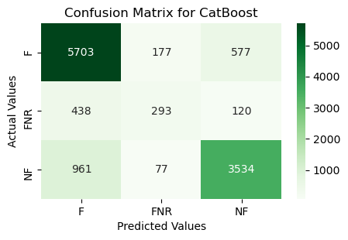
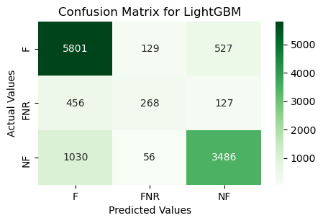

Confusion Matrices (split-train-test)

Slide 30
Example Scores
Model​ | Test Accuracy​
RandomForest​ (default) | 80.96​
XGBoost​ (default) | 80.02​
Stack (RF + Gradient Boost)​ | 70.75​
Stack (RF, Gradient boosting, LightGBM)​ | 71.25​
CatBoost​ (tuned) | 81.12 ​
Stack (RF, LightGBM, CatBoost – all tuned)​ | 81.91 ​
RandomForest – H2O module | 81.95 ​
RandomForest – H2O module, tuned | 82.01

Slide 31
Feature Descriptions
amount_tsh — Total static head (amount water available to waterpoint)
date_recorded — The date the row was entered
funder — Who funded the well
gps_height — Altitude of the well
installer — Organization that installed the well
longitude — GPS coordinate
latitude — GPS coordinate
wpt_name — Name of the waterpoint if there is one
public_meeting — True/False
recorded_by — Group entering this row of data
scheme_management — Who operates the waterpoint
num_private — No information
basin — Geographic water basin
subvillage — Geographic location
region — Geographic location
region_code — Geographic location (coded)
district_code — Geographic location (coded)
lga — Geographic location
ward — Geographic location
population — Population around the well

